Slide 1

ACADEMIC PRESENTATION
Morphological Image Processing
Guide to mathematical set theory and algorithms in computer vision
Dr. Ahmed Yousry
01

Slide 2

CHAPTER OUTLINE
Part I: Core Operations
Fit, Hit, and Miss criteria alongside fundamental Erosion & Dilation operators
02

Slide 3


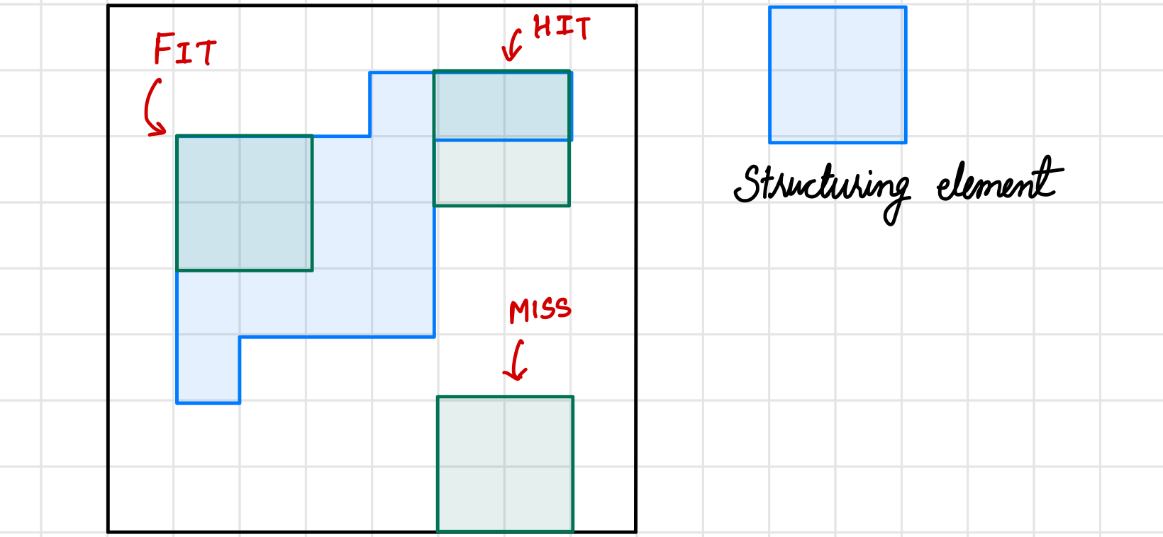
6.1 PRELIMINARIES
Mathematical Preliminaries
Morphological operations examine binary or grayscale structures by shifting a probe shape called a Structuring Element (SE) across the image plane:
Set Definitions: Foreground pixels represent set elements; background represents the empty space.
Fit Rule: Every foreground pixel of the translated structuring element completely covers the foreground set.
Hit Rule: At least one foreground pixel of the structuring element overlaps the foreground.
Miss Rule: Structuring element has zero overlapping pixels with the foreground set.
03

Slide 4
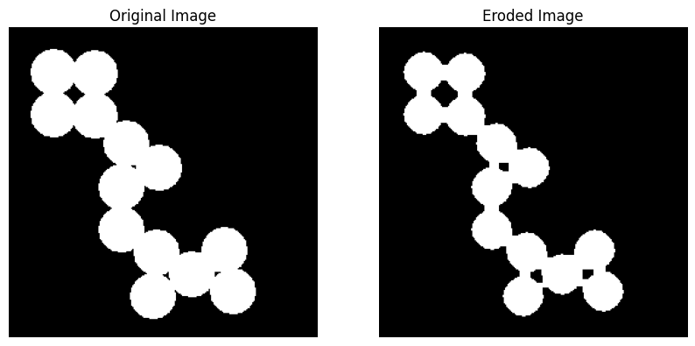
6.2.1 CORE OPERATORS
Erosion
Erosion systematically strips pixels from foreground boundaries where the structuring element does not fit perfectly.
Boundary Shrinkage: Reduces the outer width of foreground areas.
Noise Removal: Completely eliminates white noise structures smaller than the SE.
Hole Expansion: Increases the size of interior dark voids.
04

Slide 5

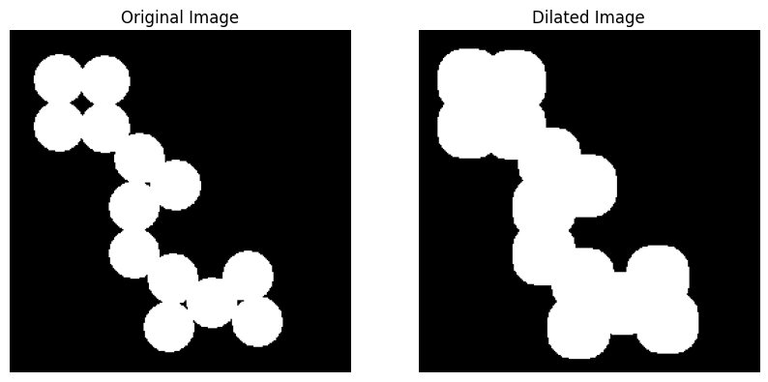
6.2.2 CORE OPERATORS
Dilation
Dilation expands the spatial extent of foreground structures by appending pixel weights wherever the probe overlaps.
Structural Growth: Magnifies pixel profiles and thickens lines.
Gap Bridging: Closes and resolves narrow channels, fractures, or disconnected lines.
Hole Sealing: Fills interior black holes smaller than the SE boundaries.
05

Slide 6



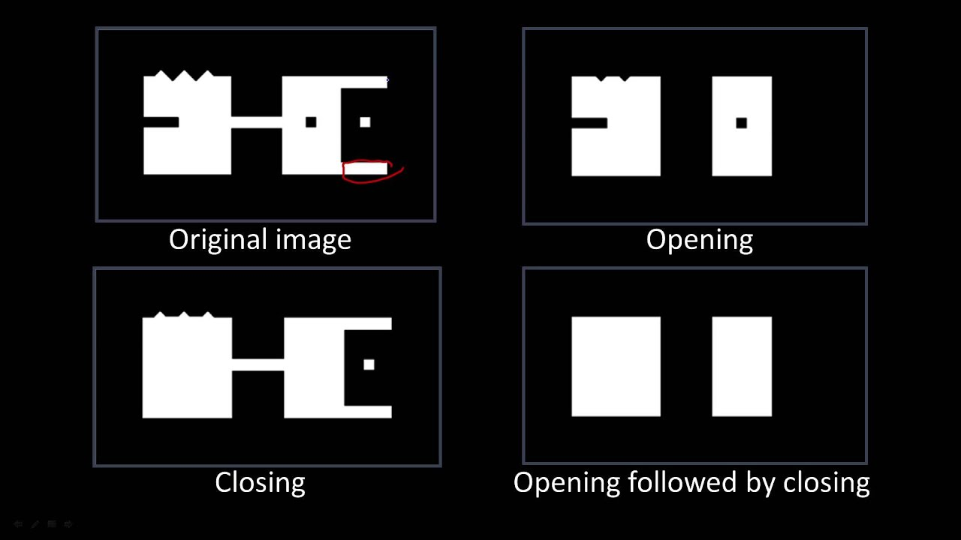
6.3 JOINT OPERATIONS
Opening and Closing
Morphological Opening (A ∘ B)
Morphological Closing (A • B)
Calculated as erosion followed sequentially by dilation with the identical structuring element:
Calculated as dilation followed sequentially by erosion with the identical structuring element:
Ideal for: Removing small spikes, fine protrusions, and background speckles while preserving structural contours.
Ideal for: Sealing interior gaps, filling small cracks, and connecting fractured target objects without resizing.
06

Slide 7

6.3 OPERATIONS MATRIX
Comparison of Core Operators
Operation | Mathematical Notation | Geometric Effect | Primary Computer Vision Purpose
Erosion | A ⊖ B | Shrinks foreground bounds | Detail elimination, binary noise smoothing
Dilation | A ⊕ B | Expands foreground bounds | Bridge broken outlines, fill black voids
Opening | A ∘ B = (A ⊖ B) ⊕ B | Smoothes contours, deletes thin spikes | Object separation, speckle noise removal
Closing | A • B = (A ⊕ B) ⊖ B | Fills narrow cracks, connects lines | Rejoining fragmented edge segments
07

Slide 8
CHAPTER OUTLINE
Part II: Morphological Algorithms
Exploring extraction pipelines: Boundary Extraction, Hole Filling, and Connected Components
08

Slide 9




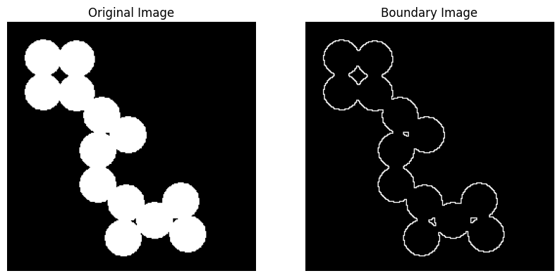
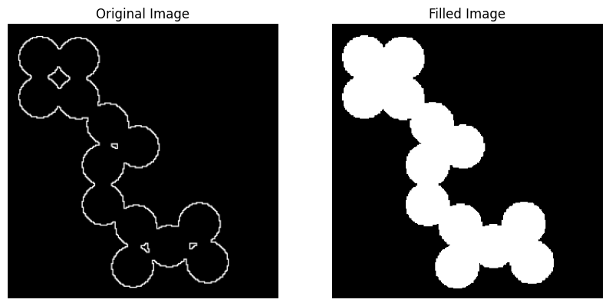
6.4 ALGORITHMS
Contours & Internal Structures
Boundary Extraction β(A)
Hole Filling Iterations
Extracted by taking the set difference between the original set and its eroded counterpart:
An iterative algorithm to fill closed background voids starting with a marker seed point:
Mechanics: Keeps only boundary pixels since the eroded core is subtracted, leaving single-pixel thin outline tracks.
Condition: Terminates when X_k+1 equals X_k. The final filled result is the union of the original set and the computed mask.
09

Slide 10






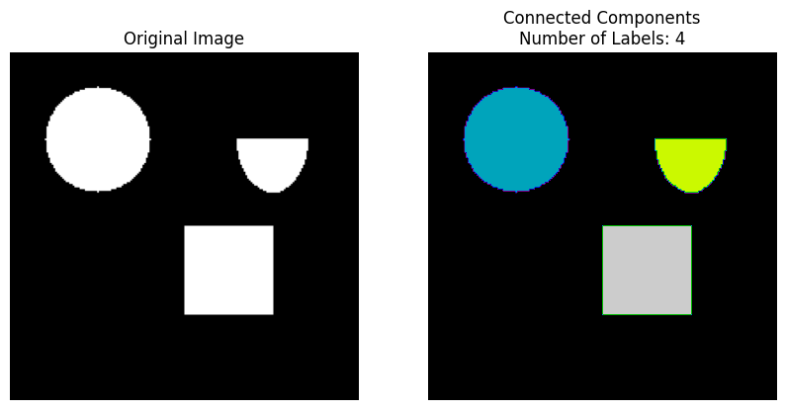
6.4.4 PIXEL CONNECTIVITY
Connected Components
1. Binarize
2. Scan & Label
3. Feature Extract
Convert grayscale images into single bit arrays using standard intensity thresholds to establish clear foregrounds.
Run adjacency scans grouping elements with 4-way or 8-way pixel connectivity. Assign individual labels to unique objects.
Perform topological analysis on each separated cluster to compute properties like centroid, area, and orientation.
10

Slide 11
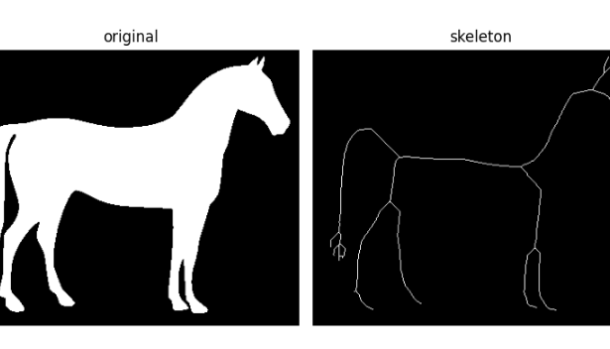


6.4.5 SHAPE REDUCTION
Skeletonization
Reduces complex 2D shapes to skeletal lines that are only one pixel wide, preserving topological characteristics and general connectivity.
Highly effective for character recognition, finger print trace mapping, and optical structural analysis where central paths matter more than volume.

Slide 12



Image Sources
https://www.cs.auckland.ac.nz/courses/compsci773s1c/lectures/ImageProcessing-html/morph-probing.gif
Source: www.cs.auckland.ac.nz
https://media.geeksforgeeks.org/wp-content/uploads/20240630234458/download-(12).png
Source: www.geeksforgeeks.org
https://scikit-image.org/docs/0.25.x/_images/sphx_glr_plot_skeleton_004.png
Source: scikit-image.org

